Slide 1

Big Data Infrastructure
Session 2: From Business Intelligence to Data Science
Jimmy Lin
University of Maryland
Monday, February 2, 2015
This work is licensed under a Creative Commons Attribution-Noncommercial-Share Alike 3.0 United States See http://creativecommons.org/licenses/by-nc-sa/3.0/us/ for details

Slide 2

Why big data?
Science
Engineering
Commerce
Source: Wikipedia (Everest)

Slide 3
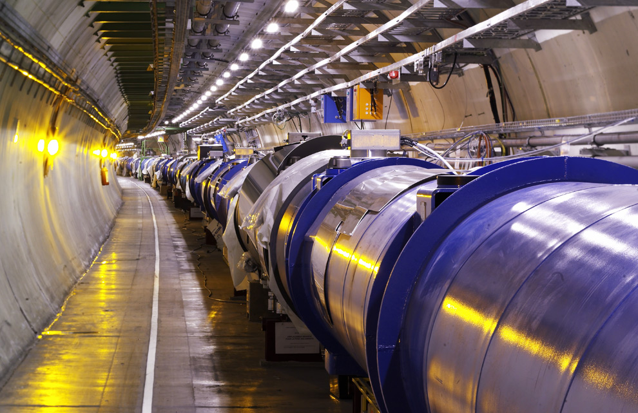
Science
Emergence of the 4th Paradigm
Data-intensive e-Science
Maximilien Brice, © CERN
Notes:
By the time it shuts down in 2011, the CERN collider should have amassed about 20 times as much data as it now has. (NYTimes article, “Trillions of Reasons to Be Excited”, 11/1/2010)

Slide 4
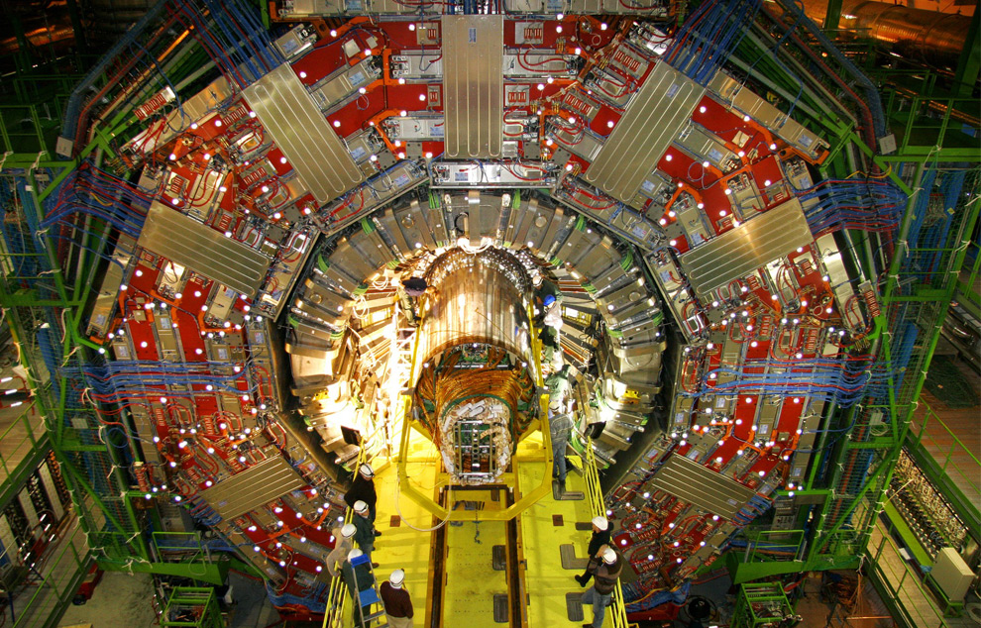
Maximilien Brice, © CERN

Slide 5
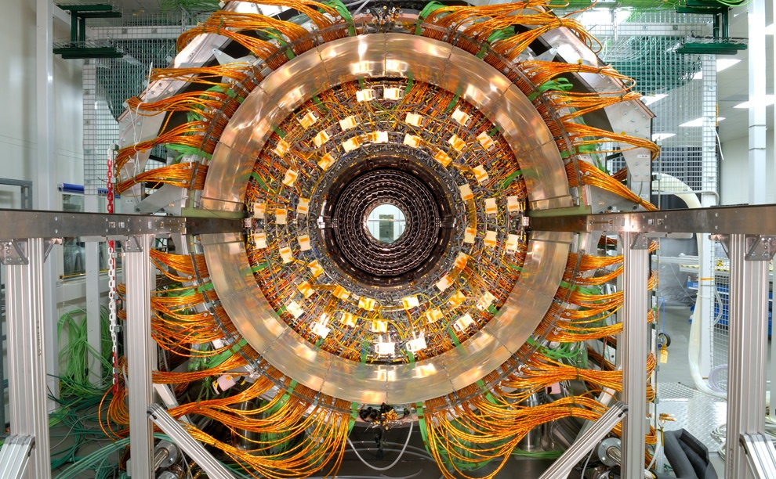
Maximilien Brice, © CERN

Slide 6

Source: Wikipedia (Hurricane)

Slide 7

Source: Wikipedia (Galaxy)

Slide 8
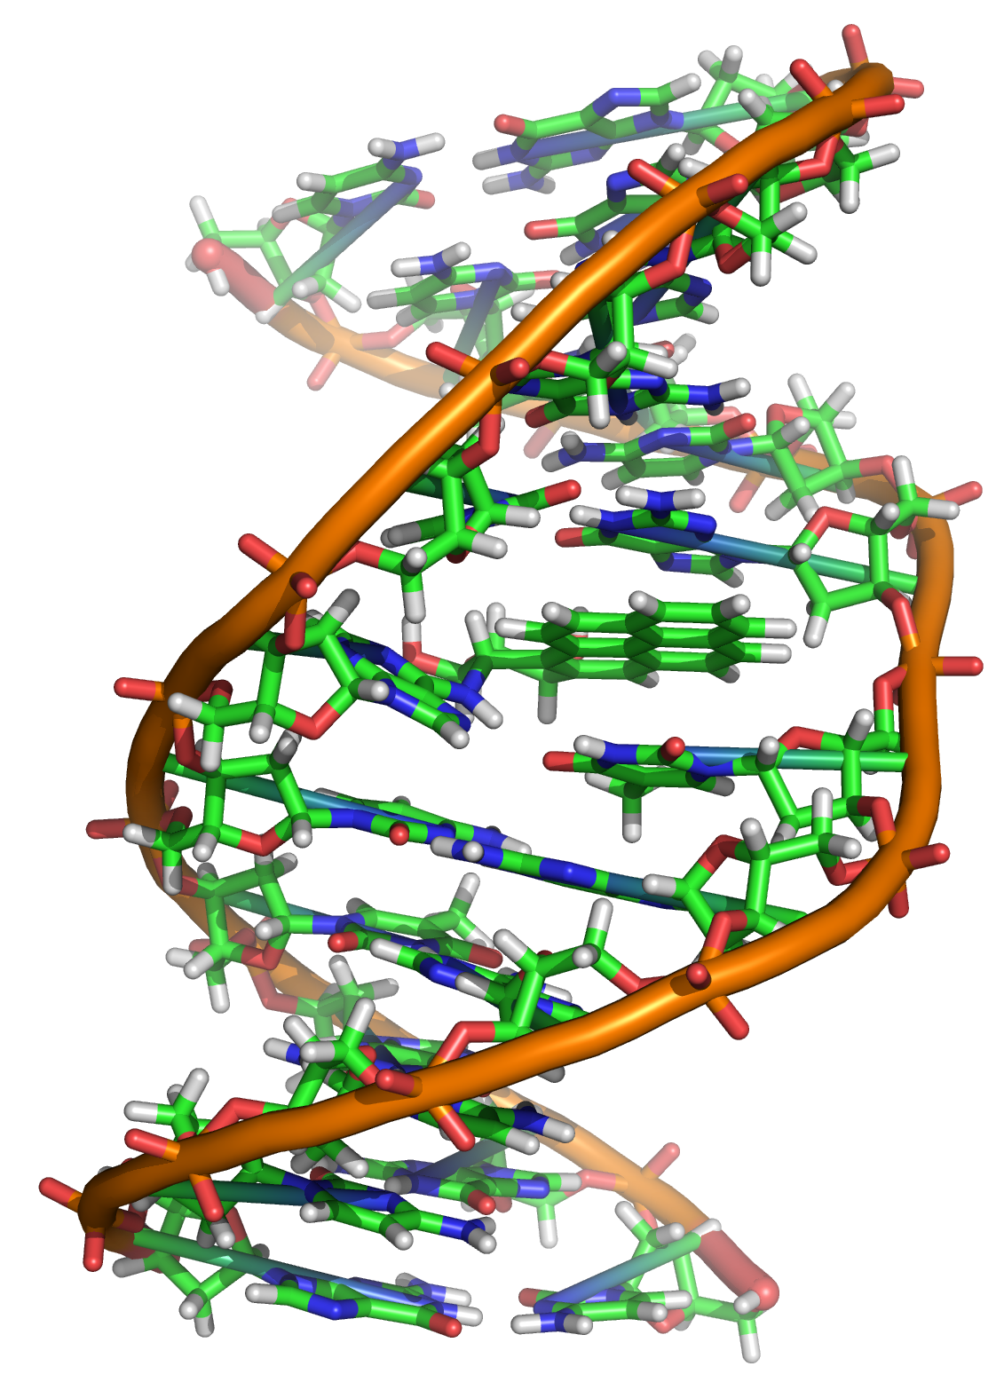
Source: Wikipedia (DNA)

Slide 9

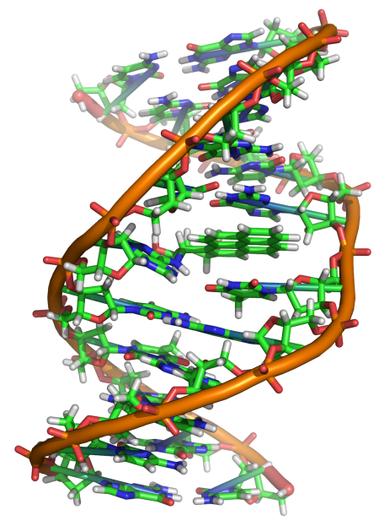
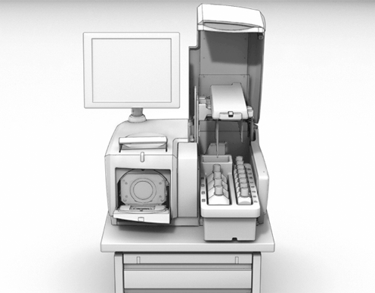
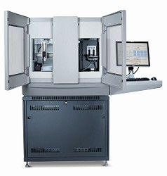
GATGCTTACTATGCGGGCCCC
CGGTCTAATGCTTACTATGC
GCTTACTATGCGGGCCCCTT
?
AATGCTTACTATGCGGGCCCCTT
TAATGCTTACTATGC
AATGCTTAGCTATGCGGGC
AATGCTTACTATGCGGGCCCCTT
AATGCTTACTATGCGGGCCCCTT
CGGTCTAGATGCTTACTATGC
AATGCTTACTATGCGGGCCCCTT
CGGTCTAATGCTTAGCTATGC
ATGCTTACTATGCGGGCCCCTT
Reads
Subject genome
Human genome: 3 gbp
A few billion short reads (~100 GB compressed data)
Sequencer

Slide 10
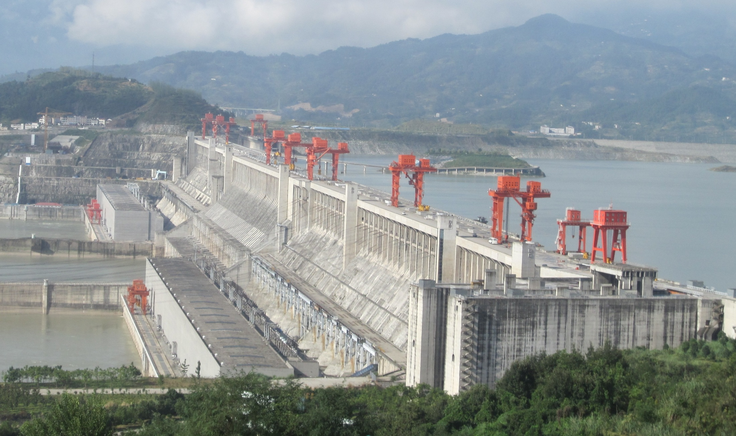
Engineering
The unreasonable effectiveness of data
Count and normalize!
Source: Wikipedia (Three Gorges Dam)

Slide 11
What to do with more data?
Answering factoid questions
Pattern matching on the Web
Works amazingly well
Learning relations
Start with seed instances
Search for patterns on the Web
Using patterns to find more instances
Who shot Abraham Lincoln? → X shot Abraham Lincoln
Wolfgang Amadeus Mozart (1756 - 1791)
Einstein was born in 1879
Birthday-of(Mozart, 1756)
Birthday-of(Einstein, 1879)
PERSON (DATE –
PERSON was born in DATE
(Brill et al., TREC 2001; Lin, ACM TOIS 2007)
(Agichtein and Gravano, DL 2000; Ravichandran and Hovy, ACL 2002; … )

Slide 12
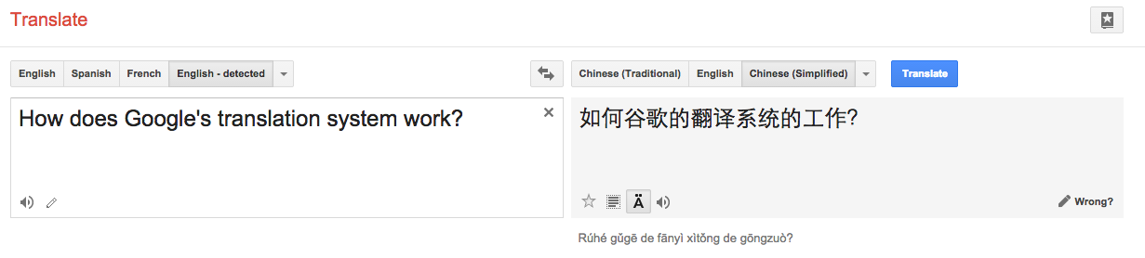

Slide 13

Source: Wikipedia (Rosetta Stone)

Slide 14
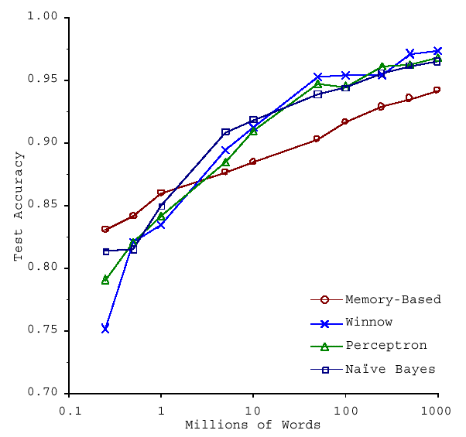
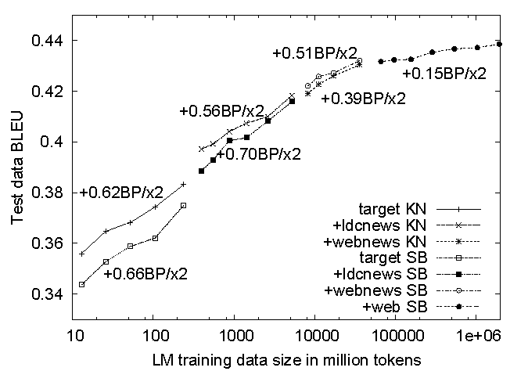
No data like more data!
s/knowledge/data/g;
(Banko and Brill, ACL 2001)
(Brants et al., EMNLP 2007)

Slide 15

Know thy customers
Data → Insights → Competitive advantages
Commerce
Source: Wikiedia (Shinjuku, Tokyo)

Slide 16
Business Intelligence
An organization should retain data that result from carrying out its mission and exploit those data to generate insights that benefit the organization, for example, market analysis, strategic planning, decision making, etc.
Duh!?

Slide 17
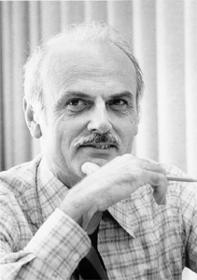
Source: Wikipedia

Slide 18
Database Workloads
OLTP (online transaction processing)
Typical applications: e-commerce, banking, airline reservations
User facing: real-time, low latency, highly-concurrent
Tasks: relatively small set of “standard” transactional queries
Data access pattern: random reads, updates, writes (involving relatively small amounts of data)
OLAP (online analytical processing)
Typical applications: business intelligence, data mining
Back-end processing: batch workloads, less concurrency
Tasks: complex analytical queries, often ad hoc
Data access pattern: table scans, large amounts of data per query

Slide 19
One Database or Two?
Downsides of co-existing OLTP and OLAP workloads
Poor memory management
Conflicting data access patterns
Variable latency
Solution: separate databases
User-facing OLTP database for high-volume transactions
Data warehouse for OLAP workloads
How do we connect the two?

Slide 20
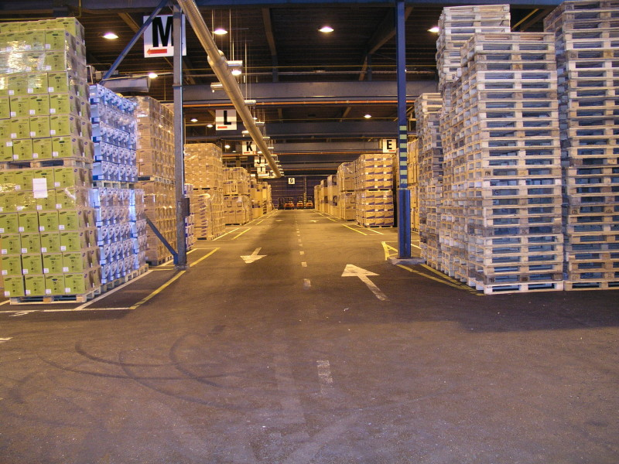
Data Warehousing
Source: Wikipedia (Warehouse)

Slide 21
OLTP/OLAP Architecture
OLTP
OLAP
ETL (Extract, Transform, and Load)

Slide 22
OLTP/OLAP Integration
OLTP database for user-facing transactions
Extract-Transform-Load (ETL)
Extract records from source
Transform: clean data, check integrity, aggregate, etc.
Load into OLAP database
OLAP database for data warehousing

Slide 23
What do you actually do?
Dashboards, report generation
Ad hoc analyses

Slide 24
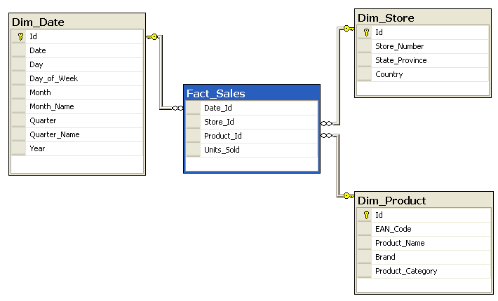
Structure of Data Warehouses
SELECT P.Brand, S.Country,
SUM(F.Units_Sold)
FROM Fact_Sales F
INNER JOIN Dim_Date D ON F.Date_Id = D.Id
INNER JOIN Dim_Store S ON F.Store_Id = S.Id
INNER JOIN Dim_Product P ON F.Product_Id = P.Id
WHERE D.YEAR = 1997 AND P.Product_Category = 'tv'
GROUP BY P.Brand, S.Country;
Source: Wikipedia (Star Schema)

Slide 25
OLAP Cubes
time
Common operations
slice and dice
roll up/drill down
pivot
product
store

Slide 26
OLAP Cubes: Research Challenges
Fundamentally, lots of group-bys and aggregations
How to take advantage of schema structure to avoid repeated work?
Cube materialization
Realistic to materialize the entire cube?
If not, how/when/what to materialize?

Slide 27
Fast forward…

Slide 28

Jeff Hammerbacher, Information Platforms and the Rise of the Data Scientist. In, Beautiful Data, O’Reilly, 2009.
“On the first day of logging the Facebook clickstream, more than 400 gigabytes of data was collected. The load, index, and aggregation processes for this data set really taxed the Oracle data warehouse. Even after significant tuning, we were unable to aggregate a day of clickstream data in less than 24 hours.”

Slide 29
ETL Bottleneck
ETL is typically a nightly task:
What happens if processing 24 hours of data takes longer than 24 hours?
Hadoop is perfect:
Ingest is limited by speed of HDFS
Scales out with more nodes
Massively parallel
Ability to use any processing tool
Cheaper than parallel databases
ETL is a batch process anyway!

Slide 30
What’s changed?
Dropping cost of disks
Cheaper to store everything than to figure out what to throw away
Types of data collected
From data that’s obviously valuable to data whose value is less apparent
Rise of social media and user-generated content
Large increase in data volume
Growing maturity of data mining techniques
Demonstrates value of data analytics

Slide 31
Virtuous Product Cycle
a useful service
$ (hopefully)
transform insights into action
analyze user behavior to extract insights

Slide 32
What do you actually do?
Dashboards, report generation
Ad hoc analyses
“Descriptive”
“Predictive”
Data products

Slide 33
Virtuous Product Cycle
a useful service
$ (hopefully)
transform insights into action
analyze user behavior to extract insights
data products
data science

Slide 34

“there are known knowns; there are things we know we know. We also know there are known unknowns; that is to say we know there are some things we do not know. But there are unknown unknowns – the ones we don't know we don't know…” – Donald Rumsfeld
Source: Wikipedia

Slide 35
Known and Unknown Unknowns
Databases are great if you know what questions to ask
“Known unknowns”
What’s if you don’t know what you’re looking for?
“Unknown unknowns”

Slide 36
OLTP/OLAP Architecture
OLTP
OLAP
ETL (Extract, Transform, and Load)

Slide 37
OLTP/OLAP/Hadoop Architecture
OLTP
Hadoop
OLAP
ETL (Extract, Transform, and Load)

Slide 38
ETL: Redux
Often, with noisy datasets, ETL is the analysis!
Note that ETL necessarily involves brute force data scans
L, then E and T?

Slide 39
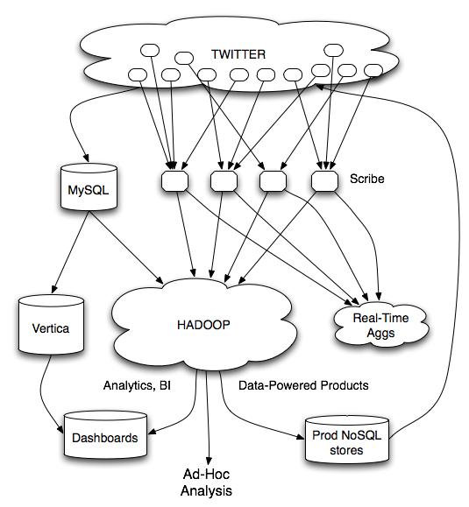
Twitter’s data warehousing architecture

Slide 40
circa ~2010
~150 people total
~60 Hadoop nodes
~6 people use analytics stack daily
circa ~2012
~1400 people total
10s of Ks of Hadoop nodes, multiple DCs
10s of PBs total Hadoop DW capacity
~100 TB ingest daily
dozens of teams use Hadoop daily
10s of Ks of Hadoop jobs daily

Slide 41
Why big data?
Science
Engineering
Commerce
Source: Wikipedia (Everest)

Slide 42

Source: Wikipedia (The Scream)

Slide 43

Source: Wikipedia (Japanese rock garden)

Slide 44
How will I actually learn Hadoop?
This class session
Hadoop: The Definitive Guide
RTFM
RTFC(!)

Slide 45
Materials in the course
The course homepage
Hadoop: The Definitive Guide
Data-Intensive Text Processing with MapReduce
Cloud⁹
Take advantage of GitHub! clone, branch, send pull request

Slide 46
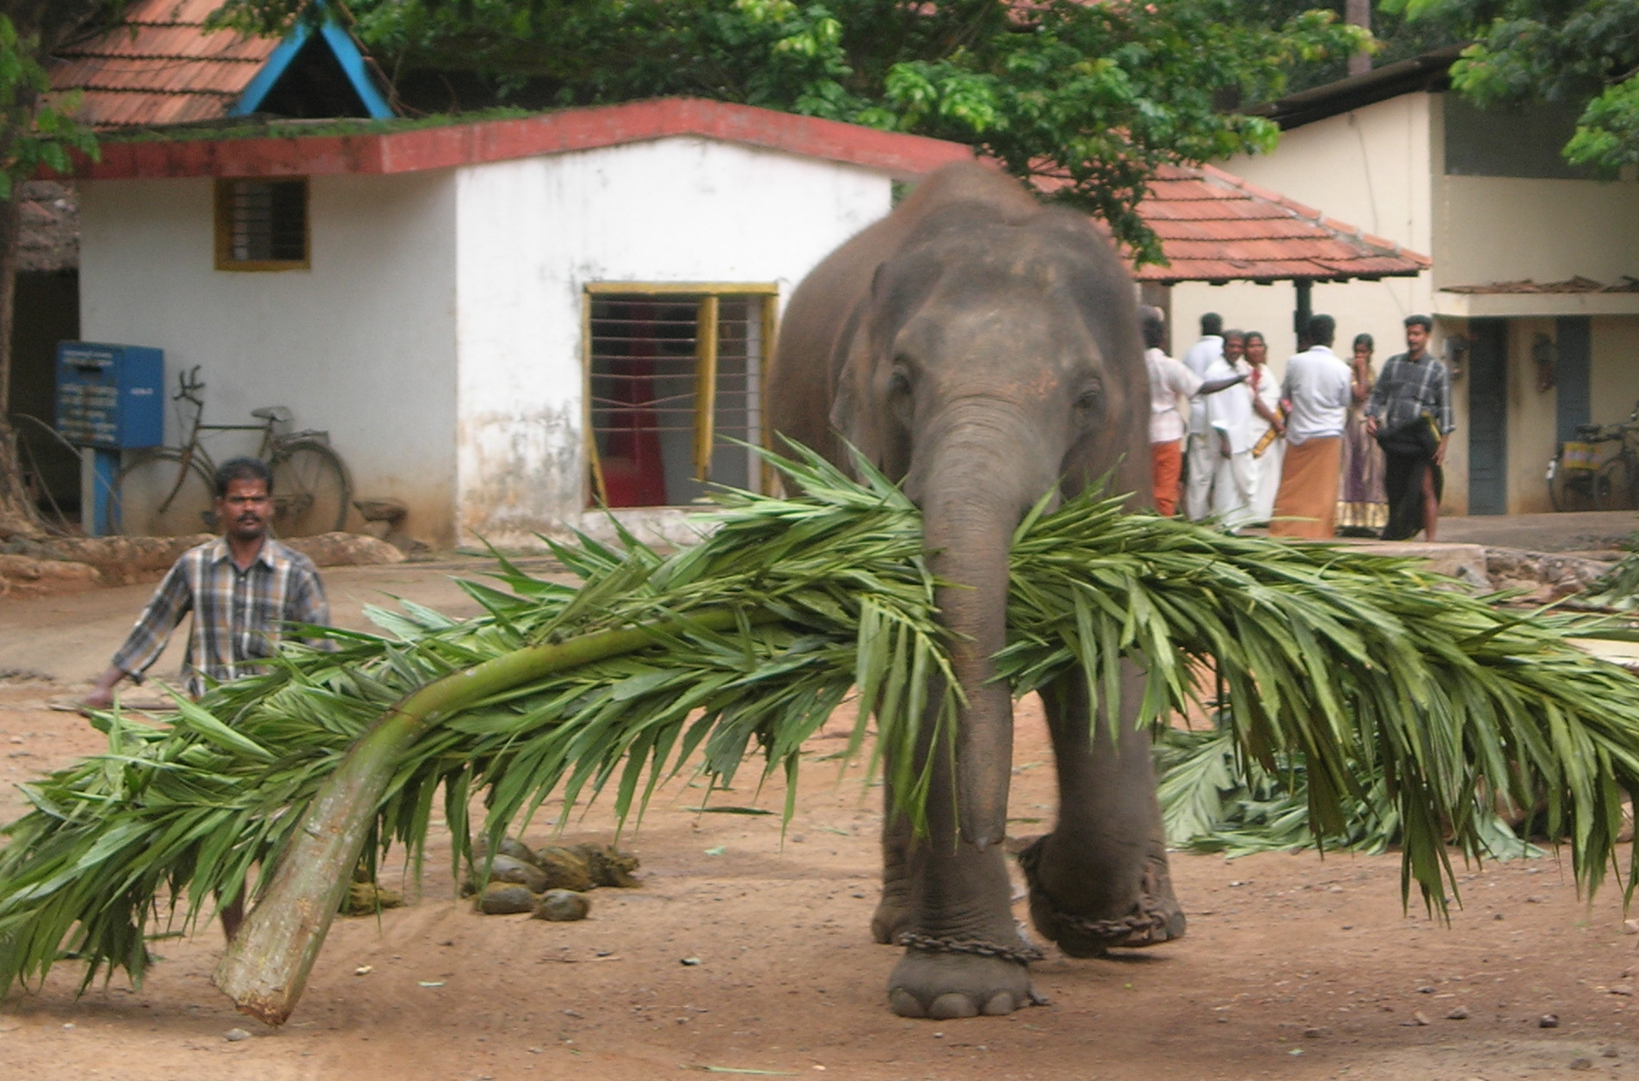
Source: Wikipedia (Mahout)

Slide 47
Basic Hadoop API*
Mapper
void setup(Mapper.Context context) Called once at the beginning of the task
void map(K key, V value, Mapper.Context context) Called once for each key/value pair in the input split
void cleanup(Mapper.Context context) Called once at the end of the task
Reducer/Combiner
void setup(Reducer.Context context) Called once at the start of the task
void reduce(K key, Iterable<V> values, Reducer.Context context) Called once for each key
void cleanup(Reducer.Context context) Called once at the end of the task
*Note that there are two versions of the API!

Slide 48
Basic Hadoop API*
Partitioner
int getPartition(K key, V value, int numPartitions) Get the partition number given total number of partitions
Job
Represents a packaged Hadoop job for submission to cluster
Need to specify input and output paths
Need to specify input and output formats
Need to specify mapper, reducer, combiner, partitioner classes
Need to specify intermediate/final key/value classes
Need to specify number of reducers (but not mappers, why?)
Don’t depend of defaults!
*Note that there are two versions of the API!

Slide 49

A tale of two packages…
org.apache.hadoop.mapreduce
org.apache.hadoop.mapred
Source: Wikipedia (Budapest)

Slide 50
Data Types in Hadoop: Keys and Values
Writable
Defines a de/serialization protocol. Every data type in Hadoop is a Writable.
WritableComprable
Defines a sort order. All keys must be of this type (but not values).
IntWritable LongWritable
Text
…
Concrete classes for different data types.
SequenceFiles
Binary encoded of a sequence of key/value pairs

Slide 51
“Hello World”: Word Count
Map(String docid, String text):
for each word w in text:
Emit(w, 1);
Reduce(String term, Iterator<Int> values):
int sum = 0;
for each v in values:
sum += v;
Emit(term, value);

Slide 52
“Hello World”: Word Count
private static class MyMapper
extends Mapper<LongWritable, Text, Text, IntWritable> {
private final static IntWritable ONE = new IntWritable(1);
private final static Text WORD = new Text();
@Override
public void map(LongWritable key, Text value, Context context)
throws IOException, InterruptedException {
String line = ((Text) value).toString();
StringTokenizer itr = new StringTokenizer(line);
while (itr.hasMoreTokens()) {
WORD.set(itr.nextToken());
context.write(WORD, ONE);
}
}
}

Slide 53
“Hello World”: Word Count
private static class MyReducer
extends Reducer<Text, IntWritable, Text, IntWritable> {
private final static IntWritable SUM = new IntWritable();
@Override
public void reduce(Text key, Iterable<IntWritable> values,
Context context) throws IOException, InterruptedException {
Iterator<IntWritable> iter = values.iterator();
int sum = 0;
while (iter.hasNext()) {
sum += iter.next().get();
}
SUM.set(sum);
context.write(key, SUM);
}
}

Slide 54
Three Gotchas
Avoid object creation if possible
Reuse Writable objects, change the payload
Execution framework reuses value object in reducer
Passing parameters via class statics

Slide 55
Getting Data to Mappers and Reducers
Configuration parameters
Directly in the Job object for parameters
“Side data”
DistributedCache
Mappers/reducers read from HDFS in setup method

Slide 56
Complex Data Types in Hadoop
How do you implement complex data types?
The easiest way:
Encoded it as Text, e.g., (a, b) = “a:b”
Use regular expressions to parse and extract data
Works, but pretty hack-ish
The hard way:
Define a custom implementation of Writable(Comprable)
Must implement: readFields, write, (compareTo)
Computationally efficient, but slow for rapid prototyping
Implement WritableComparator hook for performance
Somewhere in the middle:
Cloud⁹ (via lin.tl) offers JSON support and lots of useful Hadoop types
Quick tour…

Slide 57
Basic Cluster Components*
One of each:
Namenode (NN): master node for HDFS
Jobtracker (JT): master node for job submission
Set of each per slave machine:
Tasktracker (TT): contains multiple task slots
Datanode (DN): serves HDFS data blocks
* Not quite… leaving aside YARN for now

Slide 58
Putting everything together…
namenode
job submission node
namenode daemon
jobtracker
tasktracker
tasktracker
tasktracker
datanode daemon
datanode daemon
datanode daemon
Linux file system
Linux file system
Linux file system
…
…
…
slave node
slave node
slave node

Slide 59
Anatomy of a Job
MapReduce program in Hadoop = Hadoop job
Jobs are divided into map and reduce tasks
An instance of running a task is called a task attempt (occupies a slot)
Multiple jobs can be composed into a workflow
Job submission:
Client (i.e., driver program) creates a job, configures it, and submits it to jobtracker
That’s it! The Hadoop cluster takes over…

Slide 60
Anatomy of a Job
Behind the scenes:
Input splits are computed (on client end)
Job data (jar, configuration XML) are sent to JobTracker
JobTracker puts job data in shared location, enqueues tasks
TaskTrackers poll for tasks
Off to the races…

Slide 61
Input File
Input File
InputSplit
InputSplit
InputSplit
InputSplit
InputSplit
InputFormat
RecordReader
RecordReader
RecordReader
RecordReader
RecordReader
Mapper
Mapper
Mapper
Mapper
Mapper
Intermediates
Intermediates
Intermediates
Intermediates
Intermediates
Source: redrawn from a slide by Cloduera, cc-licensed

Slide 62
Client
Records
…
…
InputSplit
InputSplit
InputSplit
RecordReader
RecordReader
RecordReader
Mapper
Mapper
Mapper

Slide 63
Mapper
Mapper
Mapper
Mapper
Mapper
Intermediates
Intermediates
Intermediates
Intermediates
Intermediates
Partitioner
Partitioner
Partitioner
Partitioner
Partitioner
(combiners omitted here)
Intermediates
Intermediates
Intermediates
Reducer
Reducer
Reduce
Source: redrawn from a slide by Cloduera, cc-licensed

Slide 64
Reducer
Reducer
Reduce
OutputFormat
RecordWriter
RecordWriter
RecordWriter
Output File
Output File
Output File
Source: redrawn from a slide by Cloduera, cc-licensed

Slide 65
Input and Output
InputFormat:
TextInputFormat
KeyValueTextInputFormat
SequenceFileInputFormat
…
OutputFormat:
TextOutputFormat
SequenceFileOutputFormat
…

Slide 66
Shuffle and Sort in Hadoop
Probably the most complex aspect of MapReduce
Map side
Map outputs are buffered in memory in a circular buffer
When buffer reaches threshold, contents are “spilled” to disk
Spills merged in a single, partitioned file (sorted within each partition): combiner runs during the merges
Reduce side
First, map outputs are copied over to reducer machine
“Sort” is a multi-pass merge of map outputs (happens in memory and on disk): combiner runs during the merges
Final merge pass goes directly into reducer

Slide 67
Shuffle and Sort
Mapper
intermediate files (on disk)
merged spills (on disk)
Combiner
Reducer
circular buffer (in memory)
Combiner
other reducers
spills (on disk)
other mappers

Slide 68

Hadoop Workflow
1. Load data into HDFS
2. Develop code locally
3. Submit MapReduce job
3a. Go back to Step 2
Hadoop Cluster
You
4. Retrieve data from HDFS

Slide 69
Recommended Workflow
Here’s how I work:
Develop code in Eclipse on host machine
Build distribution on host machine
Check out copy of code on VM
Copy (i.e., scp) jars over to VM (in same directory structure)
Run job on VM
Iterate
…
Commit code on host machine and push
Pull from inside VM, verify
Avoid using the UI of the VM
Directly ssh into the VM

Slide 70
Debugging Hadoop
First, take a deep breath
Start small, start locally
Build incrementally

Slide 71
Code Execution Environments
Different ways to run code:
Plain Java
Local (standalone) mode
Pseudo-distributed mode
Fully-distributed mode
Learn what’s good for what

Slide 72
Hadoop Debugging Strategies
Good ol’ System.out.println
Learn to use the webapp to access logs
Logging preferred over System.out.println
Be careful how much you log!
Fail on success
Throw RuntimeExceptions and capture state
Programming is still programming
Use Hadoop as the “glue”
Implement core functionality outside mappers and reducers
Independently test (e.g., unit testing)
Compose (tested) components in mappers and reducers

Slide 73
Questions?
Source: Wikipedia (Japanese rock garden)

